Slide 1













FINAL COURSEWORK PROJECT
• •
•
Name: SRESHTHA CHATTERJEE
Subject Code: MDTS4214
Roll Number: 724

Slide 2








Refining the Dataset
Before modeling, we prepared our data by converting
Total Charges to numeric and removing empty
--■■Ill
-2
11•••._
2
records using na. omit ().
-2
-1
0
1
2
-1
0
1
Key observations from our initial distributions:
-
-2
-1
0
1
2
-2
-1
0
1
2
Monthly Charges show a multi-modal
distribution.
Tenure is heavily weighted towards long-term loyalists.
-₋₂ --··₋₁ ···
₀ ····₁ ·---₂ --
-2
-1
0
1
2

Slide 3







•
•
•
•
1
1near
ress1on
Forecasting Total Revenue
We modeled TotalCharges against tenure, charges, and seniority to find the baseline revenue drivers.
Simple regression
Multiple regression
X₁ = search spend X₂ = email volume Xa = discount level
-
Regression line
l
y
U)
₋Q)
Y1"-.
X2
«I
U)
�
>-
TotalCharges � 65.36 ( T ) + 36.12 ( M ) - 86.7 ( S )
X3/
l
Revenue (dependent variable)
Y = 130 + 13,X, + 132X2 + E
Results show that Tenure is the most significant multiplier of customer value.
X = ad spend (independent variable)
One predictor - One outcome
Multiple predictors - One outcome

Slide 4




ress1on
•
•
Logistic Regression
Predicting Customer Churn
By defining ChurnBinary, we modeled the probability of a customer leaving using a binomial link function.
Probability
2:0.5
o O O !. Class 1 (Yes)
0 0
Oo
0
"--- Sigmoid Curve
0 0
Probability
2: 0.5
O p •----► Decision Boundary
)( )(
Ii'
:
I
I
Class O (No)
)(
)(
)(
:
)
The model reached 79.2% Accuracy, identifying contract type as the primary catalyst for customer exits.
Probability 0 X
<0.5 ₋₄
I
-2
0
Decision Boundary •
Linear Score
0 Class 1 (Yes) X Class O (No)
Decision Boundary _..._.., Threshold = 0.5

Slide 5









eares e1
•
•
ors
The Approach
Using k=5, we classified customers based on their proximity to others in the normalized feature space.
Normalization
Data was scaled using a Min-Max function to ensure large variables like TotalCharges didn't overpower the model.
Efficiency
KNN achieved 76.8% Accuracy, proving highly effective at spotting cluster-based behaviors.

Slide 6




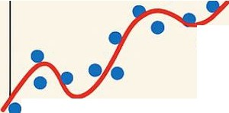




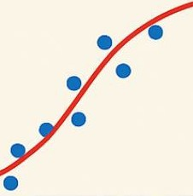
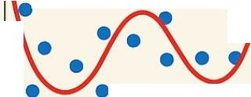
Ia
•
•
Real-Life Applications of Polynomial Regression
Capturing Non-Linearity
The relationship between time and revenue isn't always a straight line. We introduced an
$1{tenureA2)$ term to see if charges accelerate over time.
Stock Price Modeling
•
•
•
Temperature Prediction
••
• •••
•
• •
• •
• •
•
The curve confirms that revenue growth compounds
the longer a customer stays with the service.
Growth Curve in Biology
• •
Fitting Sensor Data
•
•
•
•
• •

Slide 7




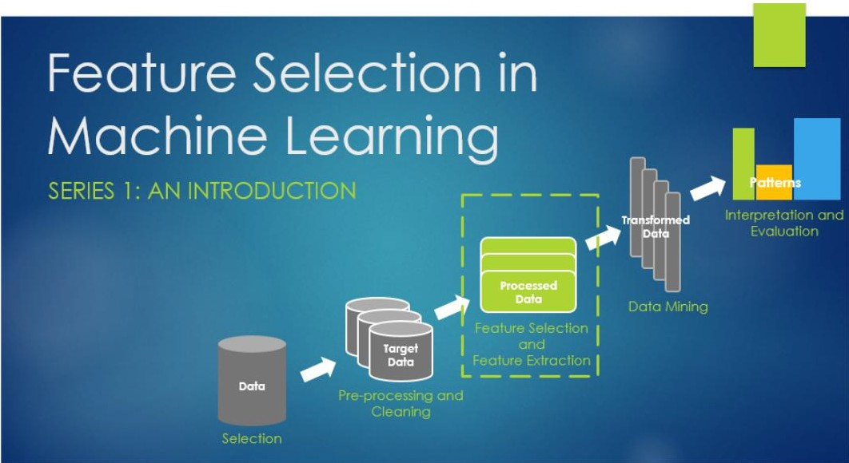
Optimizing Feature Utility
•
Using the leaps package, we evaluated all possible combinations of predictors.
By analyzing Adjusted R² and BIC, we identified the most parsimonious model that maintains maximum predictive power without overfitting.

Slide 8
1
•
•
Managing Multi-collinearity
We applied L2 regularization (Ridge) using glmnet to shrink coefficients and manage noise in the high-dimensional data.
The lambda grid search allowed us to find the optimal trade-off between bias and variance.
Total error
Optimal Model Complexity
Variance
Bias²
Model Complexity

Slide 9



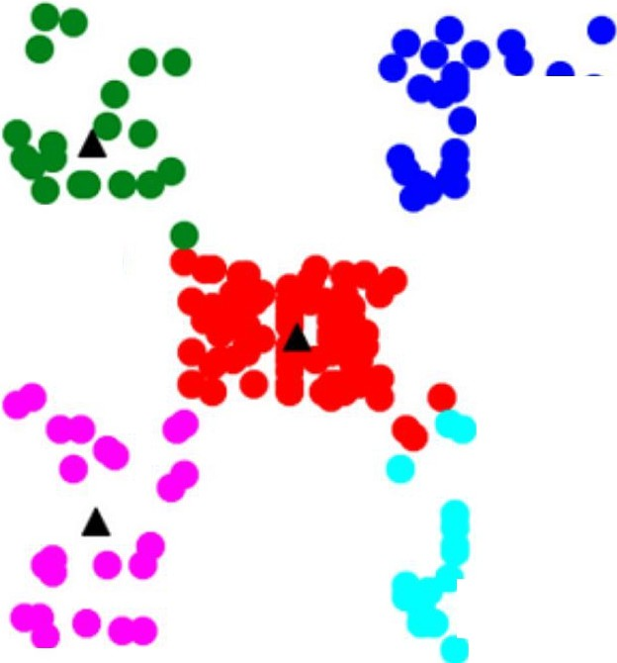




eans
Cluster d�e clientes Centro Comercial (k = 5)
100
•
• • •
Human-Centric Segmentation
Using the Elbow Method, we identified 3 distinct customer groups:
0-
80
• •
••
e Grupo 1
0
,-t
I
::! 60
(IJ
e Grupo 2
Grupo 3
Grupo 4
Grupo 5
Grupo 5
centroide
e
'-
e
0
V
Vl
O'I
-�
40
•
Low-Spend Starters: New customers.
Growth Segment: Mid-tenure users.
High-Value Loyalists: Premium long-term users.
'O
C
(IJ
Q.
Vl
•
A
20
•••
• •
•
•
0
20
40
60 80
Annual Income Ck$)
100
120
140

Slide 10


ance
Logistic Regression
KNN Classification
Key Takeaway: While both classification models perform well, Logistic Regression offers better interpretability and slightly higher accuracy for this specific customer dataset.

Slide 11


Slide 12






ources
.. .. . .
https://towardsdatascience.com/wp-content/uploads/2023/0l/1D_mNRM5RfQUqBXZTMrgjEA.png
1--rci
.) .. . .
1--1
w11
Source: towardsdatascience.com
https://funnel.io /hs-fs/hubfs/Simple%201inear%20regression%20model%20vs%20multipie.png?width=1999&height=1143&name=Sim ple%201inear%20regression%20model%20 vs%20multipie.png
·--
Source: funnel.io
https://miro.medium.com/v2/resize:fit:1358/format:webp/l*fGbmwppPjrNfJ-C90HOHIQ.png
Source: medium.com
. �
,..,,.,o,...�.
/
-I-'-.·
._:·._: .:.:_·:
https://miro.medium.com/v2/resize:fit:1400/1*6j-Akq86j2djxXyj9UjQnA.png
Source: medium.com
Learning
. 1 11
https://miro.medium.com/1*9e54W9WbwJEfrOUXKuJ-ow.png
'""'" ,.---- llr,,.. m.
:•r1.:;-u
'
!-
-
� ₋ f 1 -:· .. I
Source: medium.com
..,
..
··-----,
I .
'-----
.
Optlmal Model
compleiity
Total efror •
https://media.geeksforgeeks.org/wp-content/uploads/20251209150317698595/model_complexity.webp
Bias'
Source: www.geeksforgeeks.org

Slide 13
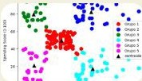
ources
https://miro.medium.com/v2/resize:fit:1004/0*dYj6e_ yYQbralGrq.png
Source: medium.com

